Slide 1

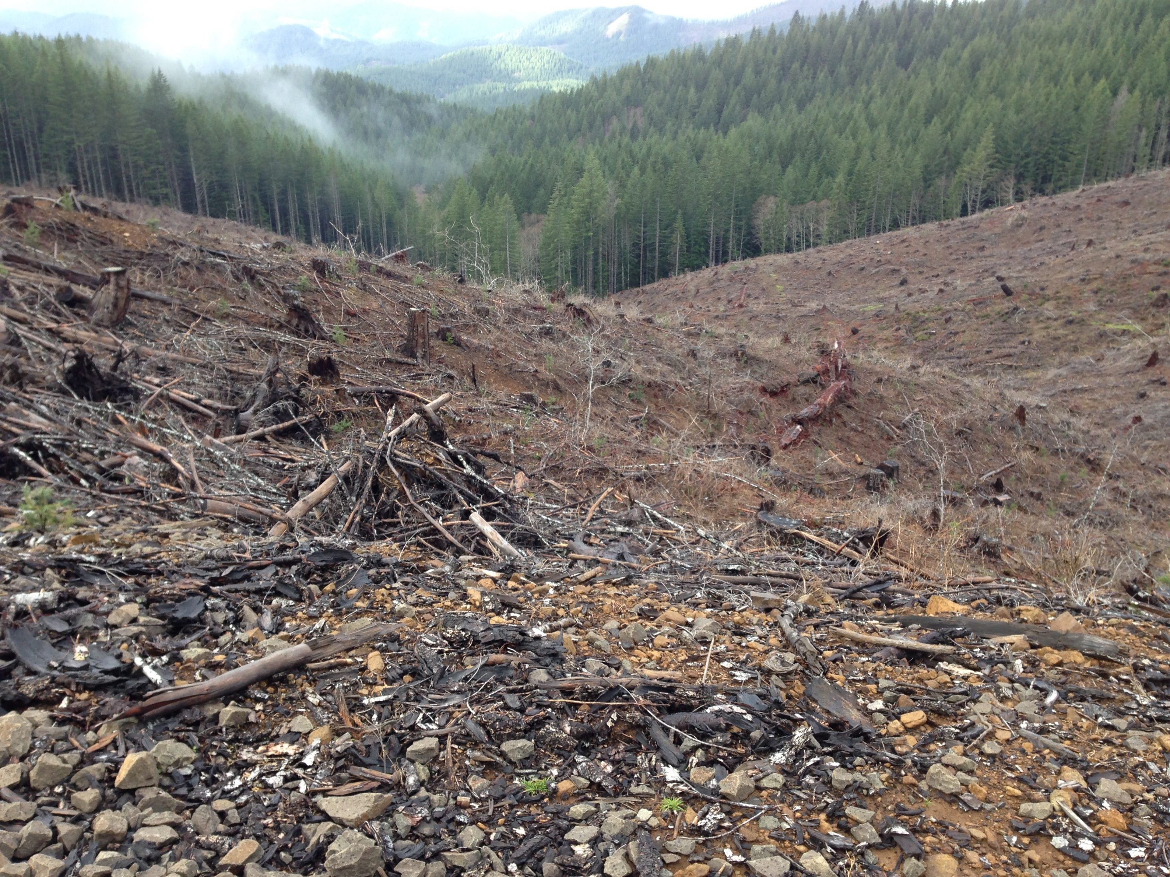
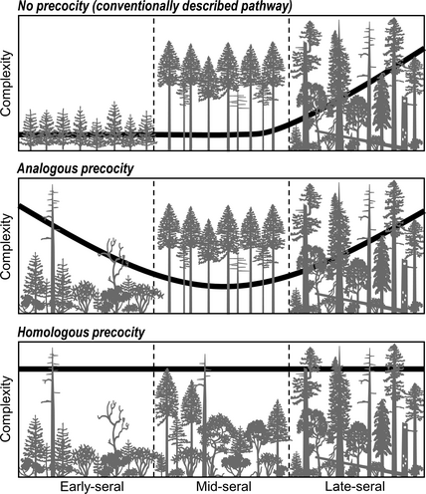
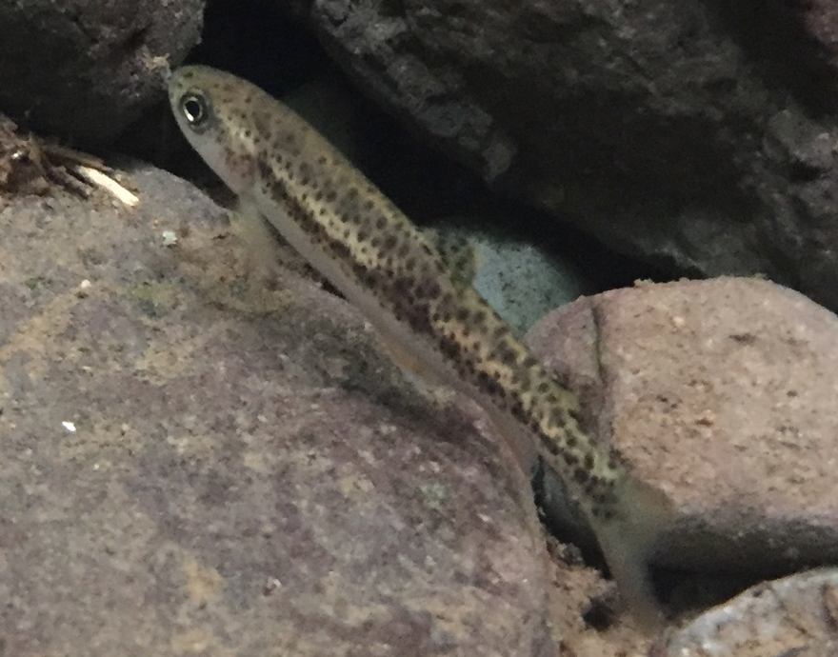
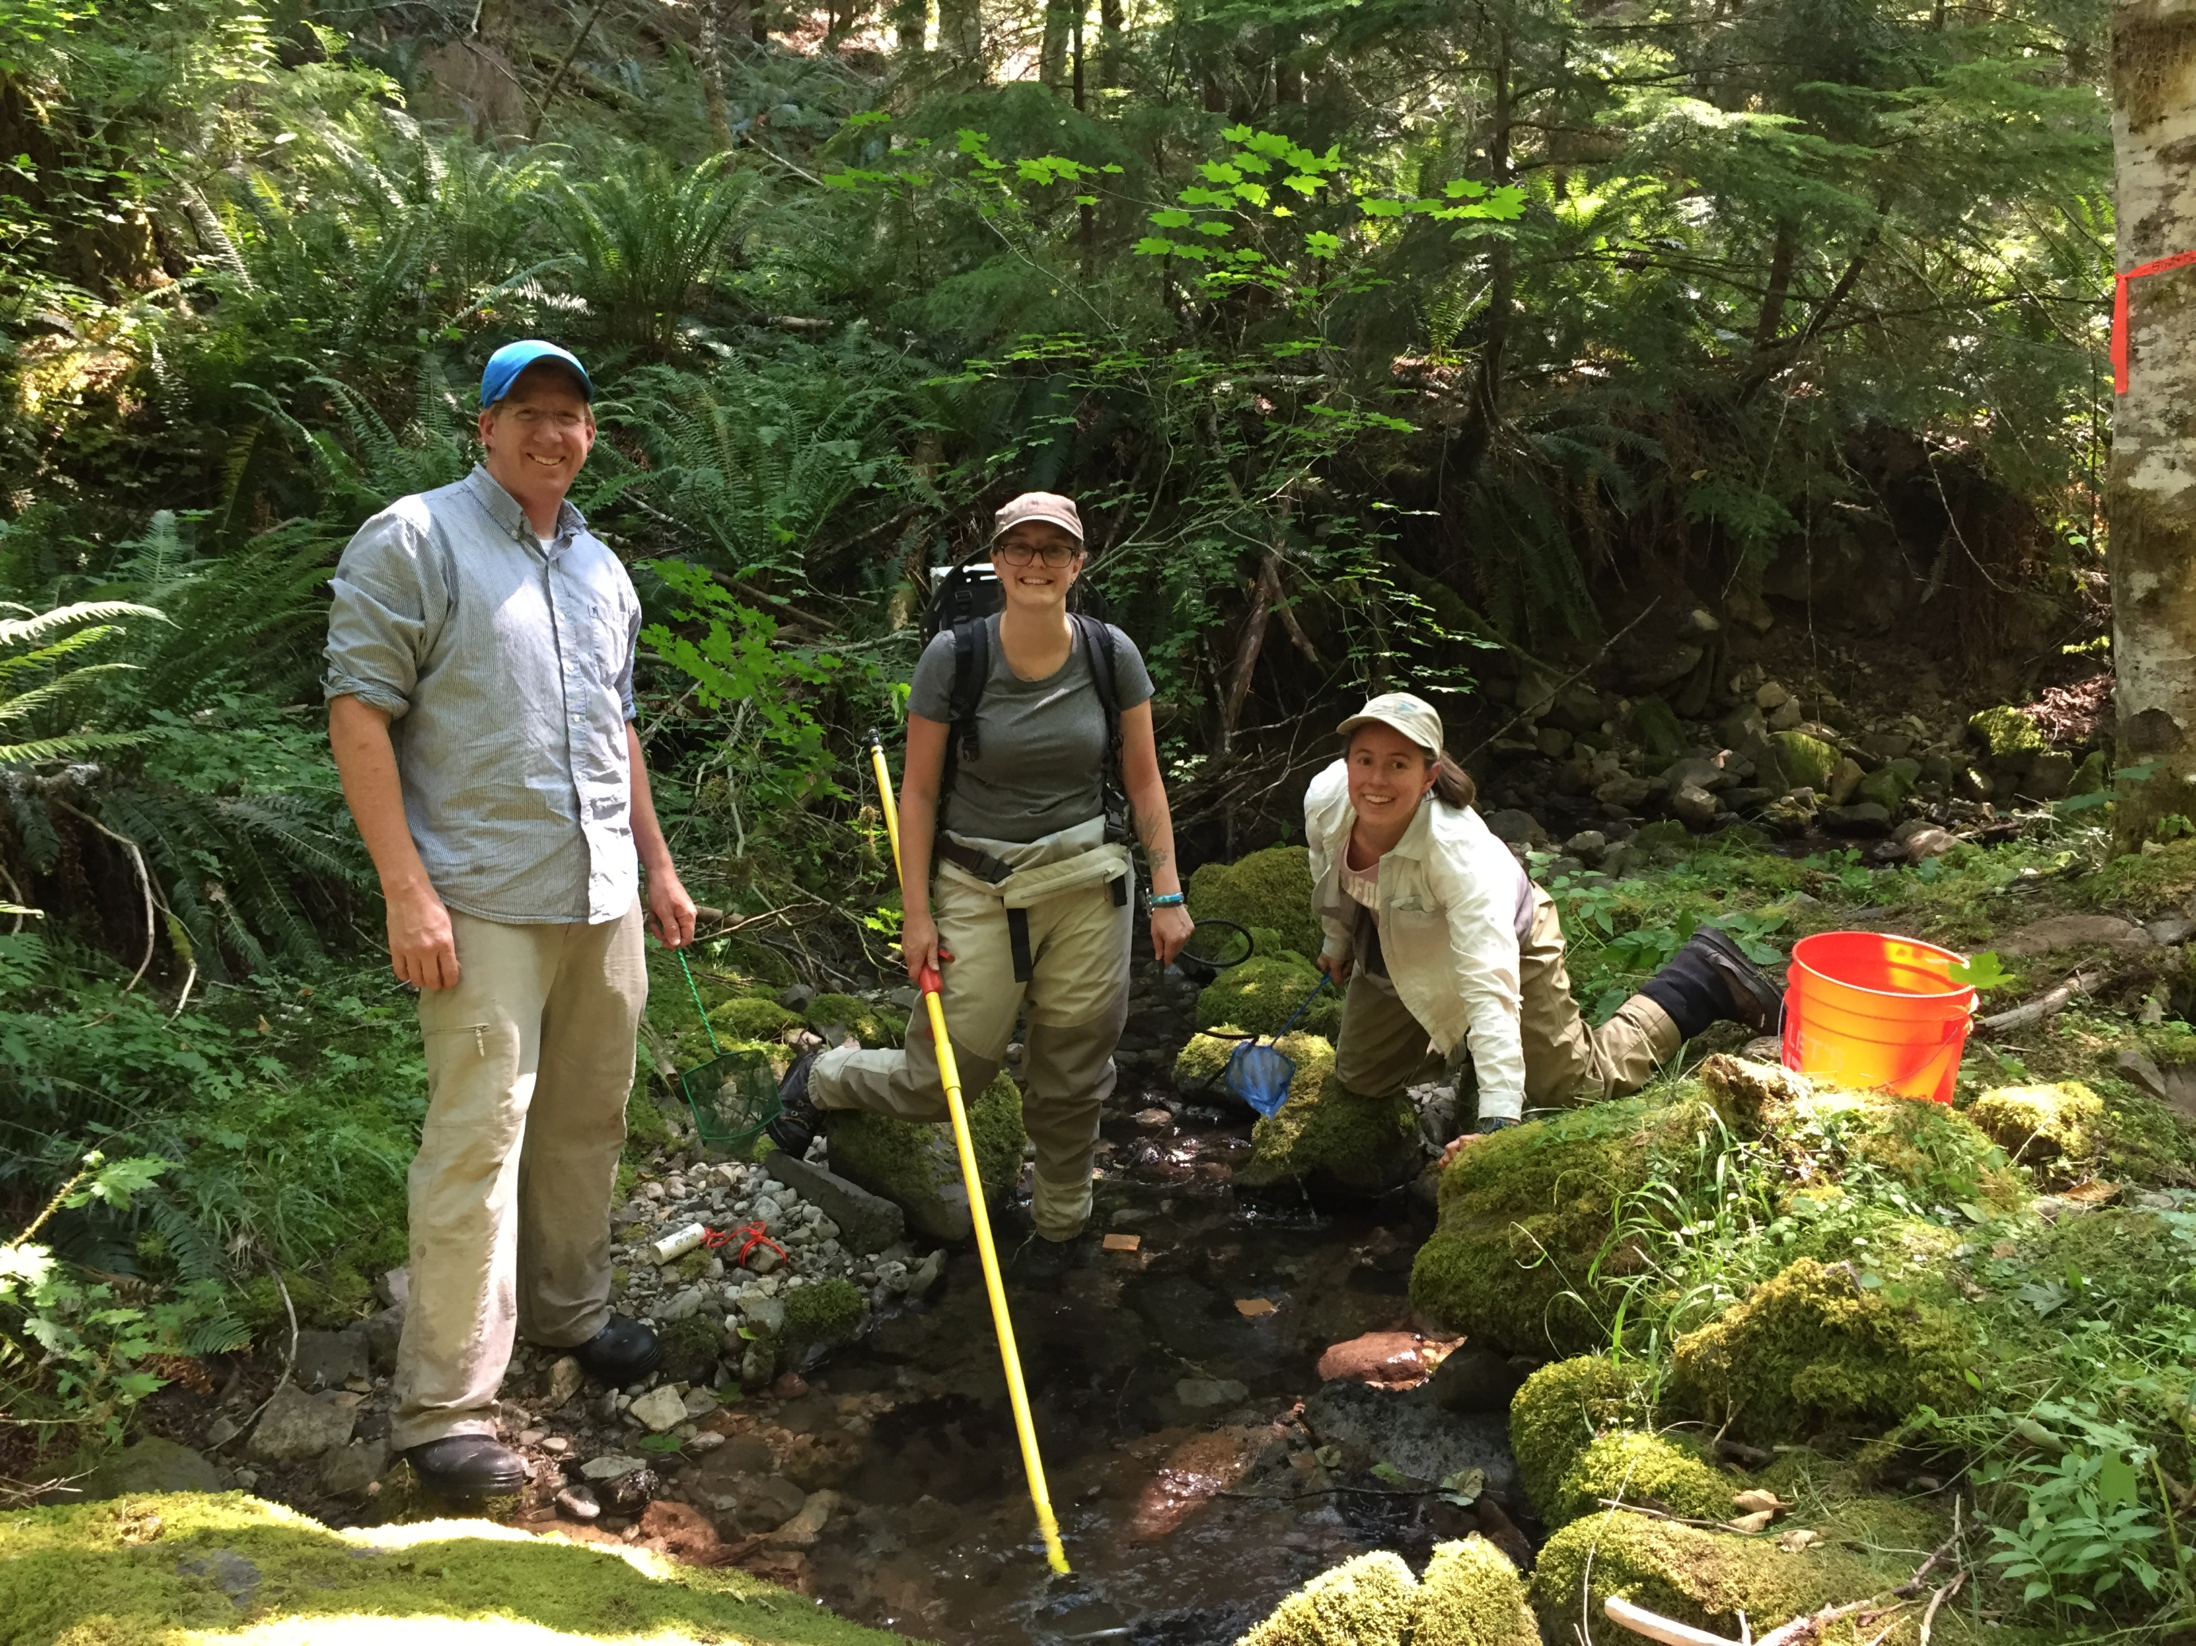
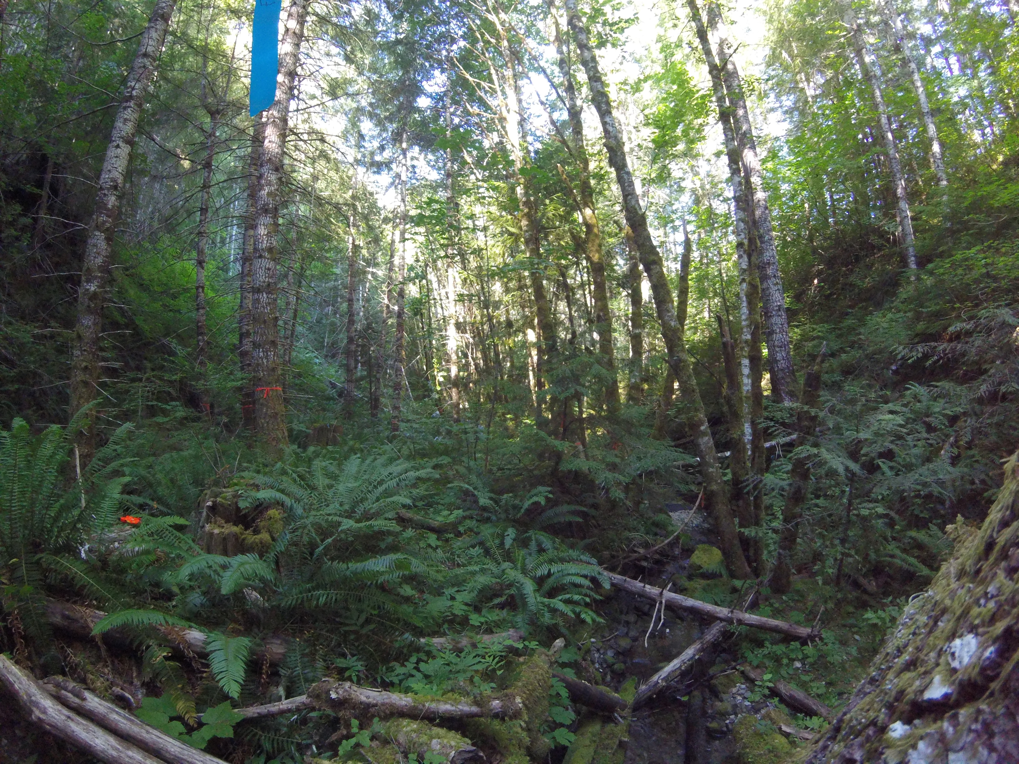
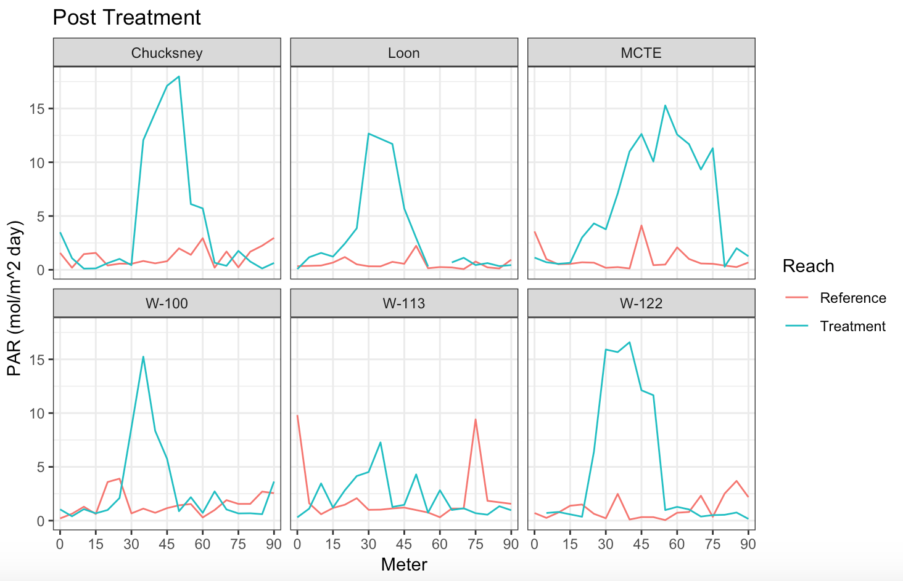
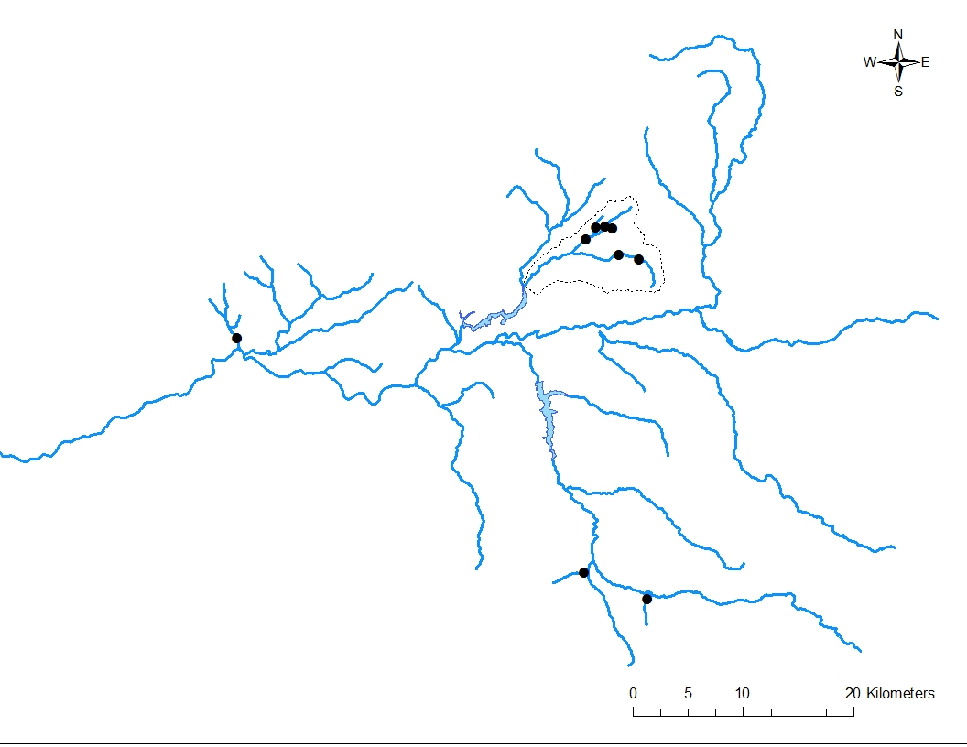
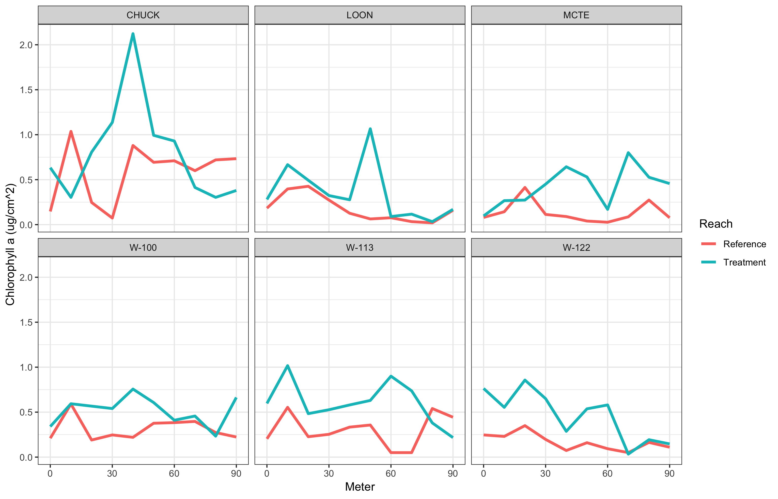
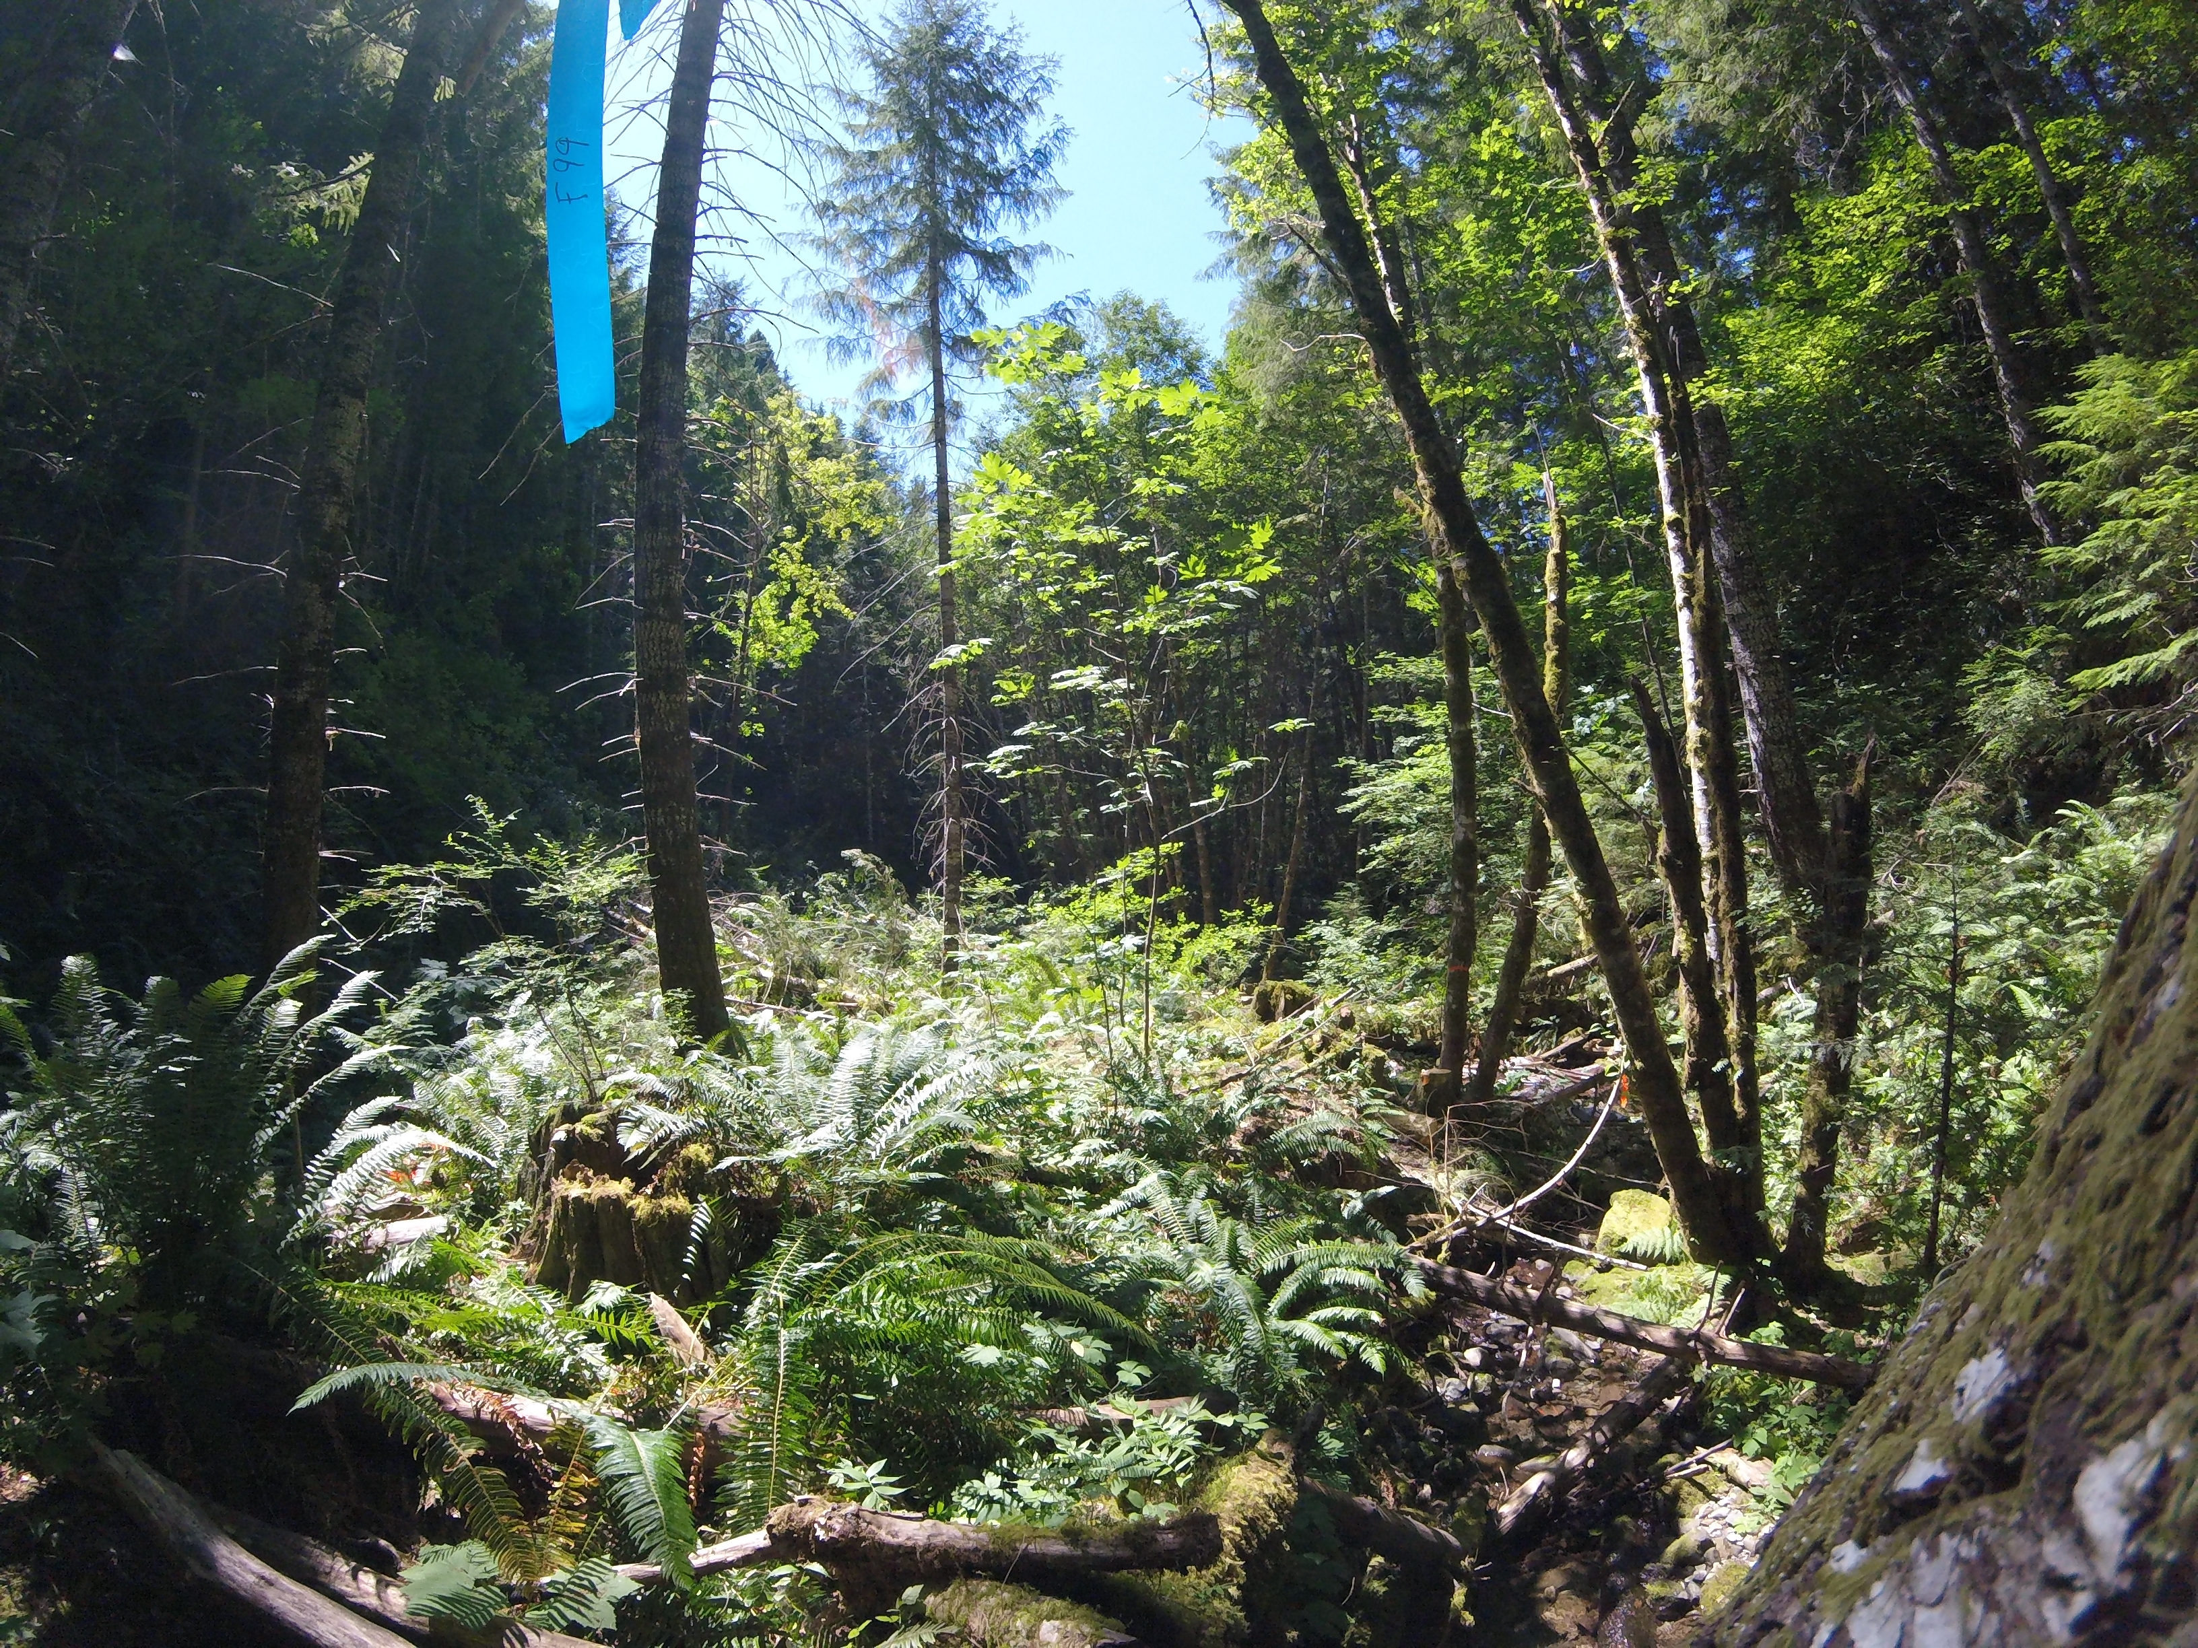
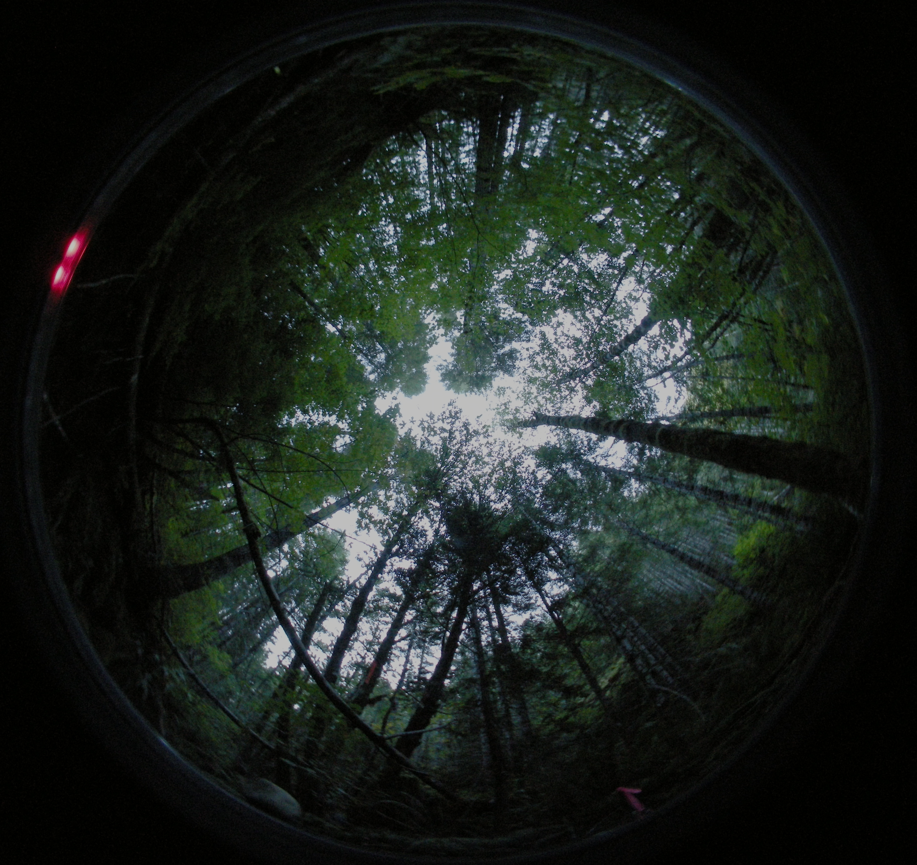
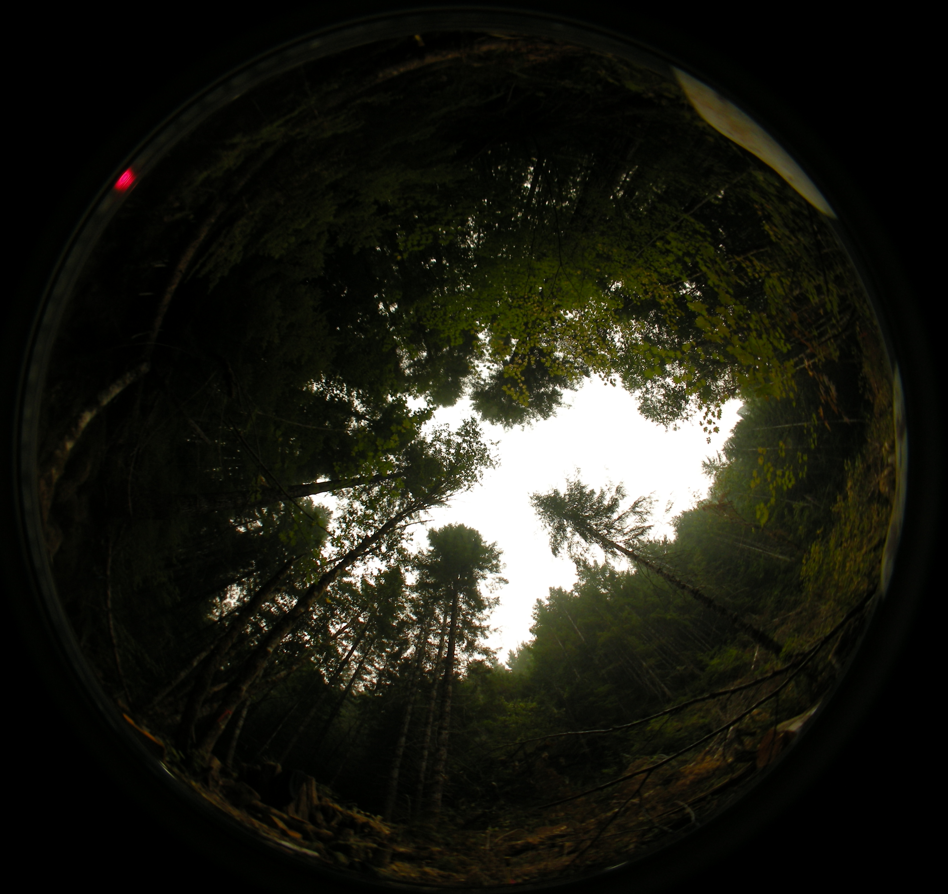
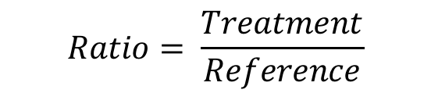
INFLUENCE OF A RIPARIAN CANOPY GAP ON A FORESTED HEADWATER STREAM
HJ Andrews Experimental Forest
Allison Swartz¹, Dana Warren^{1,2} ¹ Department of Forest Ecosystems and Society, Oregon State University, ² Department of Fish and Wildlife, Oregon State University
Short vs long term responses
BACKGROUND
RESEARCH QUESTION
DISCUSSION
Due to legacies of land use, mid-succession forests with uniformly closed canopies dominate much of temperate North America.
In these heavily shaded environments, light availability limits primary production and in-turn nutrient retention and secondary production in headwater streams.
How does a riparian canopy gap affect primary production and nutrient uptake in a headwater stream?
Implementation of a canopy gap resulted in a 16-fold increase in light and an 8-fold increase in chlorophyll-α directly below the gap (Fig 6, Fig 7).
Treatment reaches had greater nutrient demand relative to the references reaches after the creation of the gap.
Small increases in light reaching the stream benthos may have a disproportionate influence on aquatic ecosystem processes.
We expect the increase in autochthonous food availability to result in increases in vertebrate biomass (Fig 8).
Light limitation may be a key impediment to benthic primary production and nutrient retention in headwater ecosystems.
Canopy Gap
RESULTS
Figure 3. Cartoon experimental design for canopy gap implementation. Points are sampling locations of light and chlorophyll-α.
Benthic Light Availability
Benthic algae is an important resource at the base of stream food webs.
Light limitation may be a key factor controlling benthic primary production in forested headwaters.
Streams with old-growth riparian forests often have canopy gaps adjacent to the stream (Fig 4).
Streams with old-growth riparian forests often have canopy gaps adjacent to the stream (Fig 2).
Reference
Reach
Results suggest the potential for a bottom-up response to localized increases in light.
Food availability strongly influences fish production in headwater systems.
TARGET BENTHIC
LIGHT ENVIRONMENT:
Light limitation may be a key factor controlling benthic primary production in forested headwaters.
Figure 4. Daily accumulated photosynthetically active radiation (PAR) measured every 5m in the reference and treatment reaches along the stream benthos before the treatment in 2014, 2016, and 2017, immediately after the gap cut in 2017, and one year after in 2018. The large increases in PAR after the treatment aligned with the target benthic light environment naturally found in old-growth systems.
Buffer not to scale
Large gap
Small gap
Primary Production
Figure 8. Resident Cutthroat trout in the reference reach of McRae Tributary-East.
These reaches with patchy elevated light have higher primary production and fish abundance (Fig 1).
Figure 1. Cartoon of light availability to the stream benthos due to differing canopy structures. Second-growth forests have uniformly closed canopies limited light penetration, whereas complex old-growth structure has canopy gaps creating localized increases in light reaching the stream benthos.
Figure 9. Electroshocking the McRae Tributary-East reference reach in 2017.
Localized increases in light due to canopy gaps can create hotspots of primary production and nutrient retention.
Figure 2. Benthic light availability in the upstream old-growth section of McRae Creek Tributary-East.
FUTURE RESEARCH
Treatment
Reach
This study is replicated at 5 additional sites within the McKenzie River Basin, OR.
Figure 1. Difference in biomass versus difference in canopy openness among 9 paired stream reaches in the central cascades, OR, showing a strong positive relationship between light and vertebrate abundance
Little is know about key mechanistic processes around how localized changes in light affect stream ecosystems.
Figure 5. Average chlorophyll α accrual on 3 ceramic tiles placed every 10m on the stream benthos in 2016 and 2017 before the treatment, and in 2017 immediately after the cut.
Nutrient Uptake
$$Ratio= \frac{Treatment}{Reference}$$
Replication at 5 additional sites with in the McKenzie River Basin.
Bankfull widths ranging 4-9 meters.
METHODS
Gaps cut Fall 2017
McRae Creek Tributary-East is small headwater stream in the HJ Andrews Experimental Forest draining into the McKenzie River Basin.
A circular cut with a 10m radius was implemented in the streamside forest of the treatment reach (Fig 3).
Benthic light availability was measured via fluorescein decay in vials every 5m.
Chlorophyll α accumulation was measured every 10m on ceramic tiles with a bbe Benthotorch fluorometer.
Short term nutrient retention was measured with pulse release tracer injections.
Ratio of NO₃-N Uptake Velocity, Vf
Figure 11. 2018 post-treatment photosynthetically active radiation (PAR) in the reference and treatment reaches at all six site replicates.
Gap cut
Summer 2017
Pre - 1
2016
Pre – 2
2016
Pre - 3
2017
Post - 1
2017
Post - 2
2017
Post - 3
2018
Post - 4
2018
Post - 5
2018
Gaps cut Spring 2018
Figure 6. Ratios of NO₃-N uptake velocity in the treatment reach versus the reference reach before, immediately after, and one year after implementation of the riparian canopy gap.
Figure 12. 2018 post-treatment chlorophyll-a in the reference and treatment reaches at all six site replicates.
ACKNOWLEDGEMENTS
Figure 3. View from meter 25 of the treatment reach looking downstream into the gap the same day before (above) and after (below) the cut. Blue lines indicate the general stream location.
FWHMF, HJ Andrews Experimental Forest, Greg Downing, Jay Sexton, Mark Schultz, Maryanne Reiter, Sherri Johnson, Ray Rivera, Cedar Mackaness, Alvaro Cortes, Matt Kaylor, Brian Verwey, Steve Perakis, Brook Mackaness Nate Day, Corey Culp
Figure 7. Hemispherical photographs at meter 50 of the treatment reach taken in 2016 before the gap cut (left) and after in 2017 (right).
PH
Figure 8. Biomass (g/m²) response ratios (treatment reach/reference reach) of adult cutthroat trout (Oncorhynchus clarkii), age 0 Cutthroat trout, and Pacific Giant Salamander (Dicamptodon tenebrosus) from pre-treatment electroshocking surveys in 2014-2017. 2018 post-treatment values are predicted one year responses to the gap.
Figure 11. All six site locations in the McKenzie River Basin. Pre-treatment data were collected in summer 2017 and post-treatment data will be collected in summer 2018.

